Slide 1

Inspiring Leadership Through the Management of Change
A Leadership Programme for School Improvement
Creating a climate where everyone can see what needs to be done and is excited about doing it
Notes:
JLD to do welcome, housekeeping, introductions and aims.

Slide 2

Leading School Improvement
Aims:
Explore change management for school improvement
Define roles and responsibilities for school improvement
Define the role of monitoring and evaluation
Increase understanding of the steps to successful improvement planning

Slide 3


What is Change Management?
Notes:
Groups to consider what they see as change management
Take one thing from each group.

Slide 4

Change management is a structured approach to moving an organisation from the current state to the desired future state (through the people who work in the organisation).
Association of Project Management
Notes:
Read definition
When we do redundancies or restructures we often talk about change management but what it really refers to is that structured approach, plan to get you from where you are now to where you want to be.
The bit in brackets is something I have added, because the change can’t happen without the people who work in the organisation.

Slide 5
Do we need to change?
Why?
How does change affect us?
Notes:
Groups to discuss.
Ask Big question – do we need to change? Hope no-one says no!
Explore feedback from groups on why
Explore feedback on how change affects us.

Slide 6

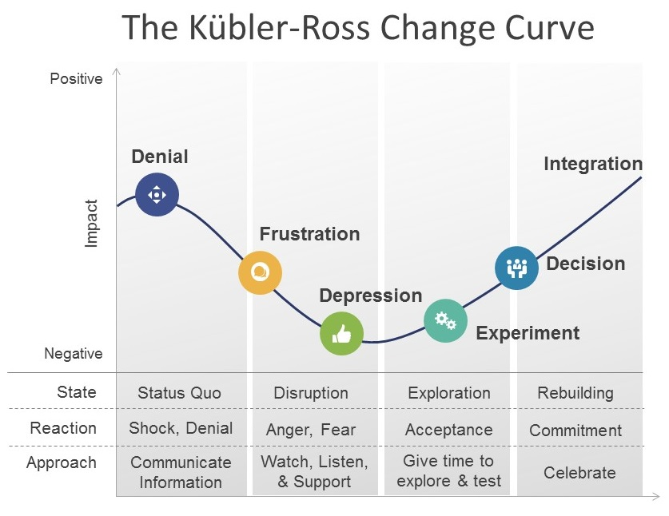
Notes:
Talked about change and how it can affect us, many of you will be familiar with the Kubler-Ross change curve.
This version is quite useful as it summarises the stages we go through both as an individual and as a group. Not going to describe it as a team, because at this stage, everyone will be in a different place.
Some will be very much at the denial stage, won’t recognise what is being said at all, thinks it is all a rouse to get rid of them. Others will be straight in at the acceptance and lets get going stage, why hasn’t something been done before this.
Think about the recommended approach, very much in the early stages give as much information about what is going on as possible. There can be information overload, but this is about trying to address their perceived fears and worries. Some of you will have heard me say this before, but people aren’t averse to change, they are averse to being changed. They need to understand why changing is better than staying as they are, but remember we reach the position where we are from our experiences, beliefs and the culture we have operated in, so we then need to rationalise/internalise that something else is better.
If you have people who are already on board and ready to go, think about how you can get them to help you.
Thinking about your school improvement journey to date, take a few moments to identify where you believe you are on the curve.
Now with the person you came with, where do you think the staff are?
Finally on your table, discuss the implications of where you think staff are. Think about where you are, are you further ahead, why might that be?

Slide 7
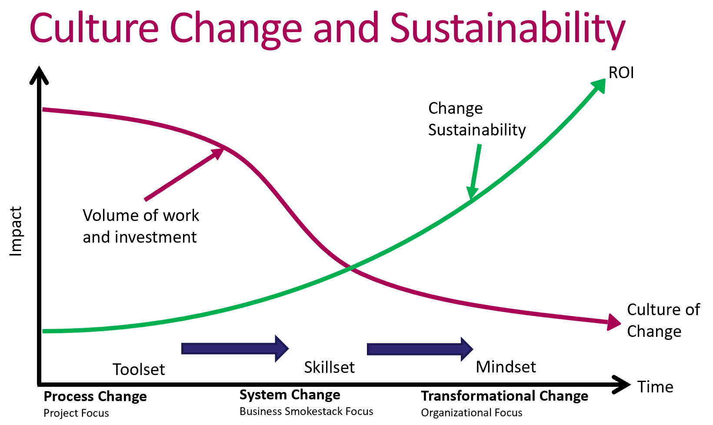
Notes:
Takes a lot of work to make things happen and at the early stages it can be frustrating, as you are investing a lot but may not see the return.
Hopefully you will all recognise this model. It reflects the SIJ we talk about when you start with a project group.

Slide 8
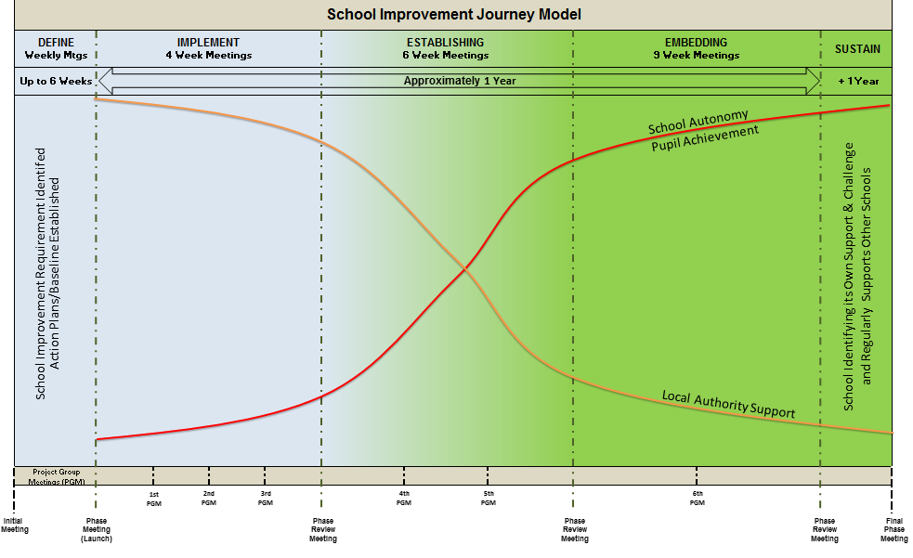
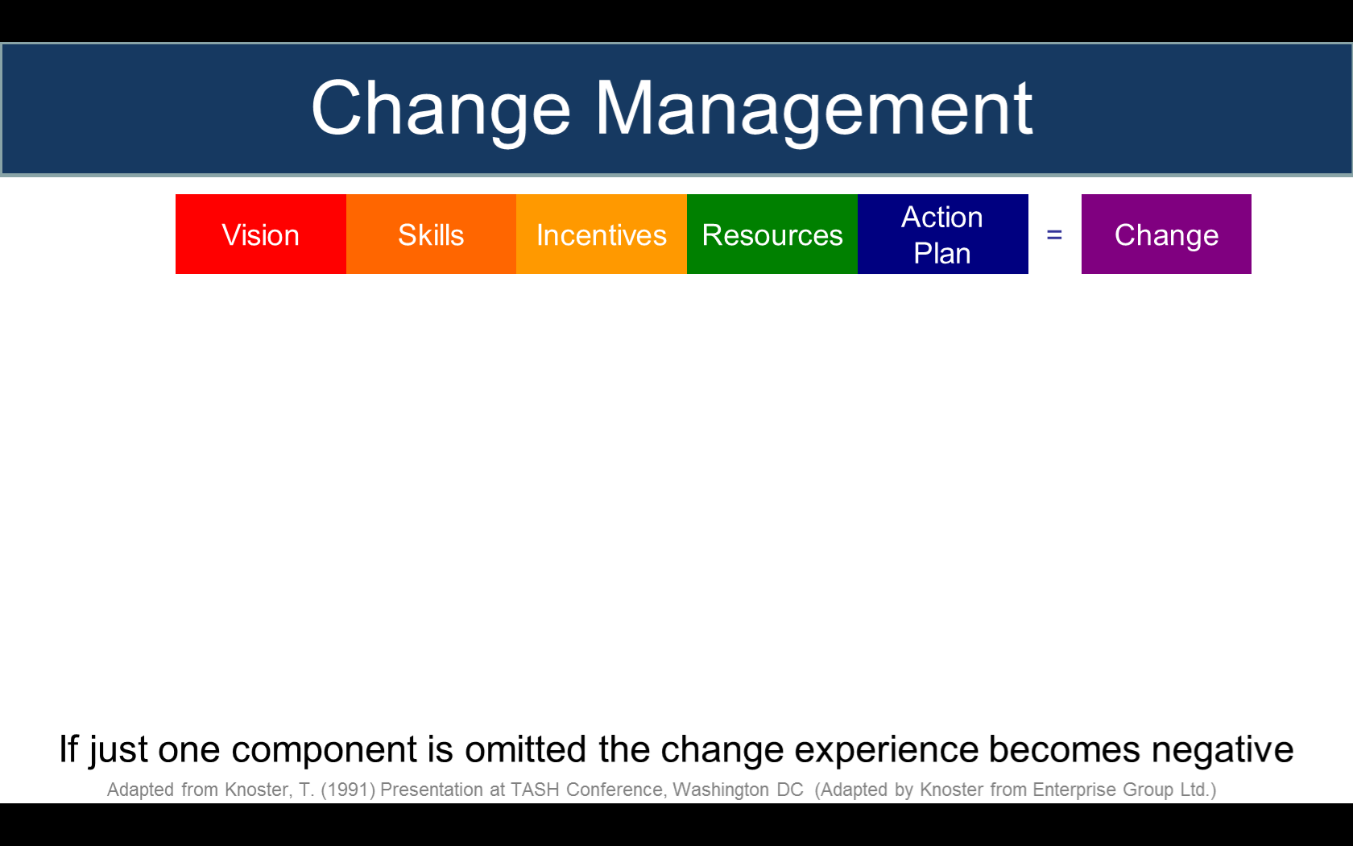
Notes:
SIJ model

Slide 9
What are the key components and principles of successful school improvement?
Notes:
Group to have time here to talk about what they perceive to be the components.
We will collect their responses to share and feedback, as part of the programme.

Slide 10
School improvement
Clear vision
Right culture
Sense of urgency
Focus on the priorities
Clarity of roles & responsibilities
Engagement of staff – buy in
A plan!

Slide 11
Change Management
Vision
Skills
Incentives
Resources
Action
Plan
=
Skills
Incentives
Resources
Action
Plan
=
Vision
Incentives
Resources
Action
Plan
=
Vision
Skills
Resources
Action
Plan
=
Vision
Skills
Incentives
Action
Plan
=
Vision
Skills
Incentives
Resources
=
If just one component is omitted the change experience becomes negative
Adapted from Knoster, T. (1991) Presentation at TASH Conference, Washington DCdaptedrom Enterprise Group Ltd.)
Adapted from Knoster, T. (1991) Presentation at TASH Conference, Washington DC (Adapted by Knoster from Enterprise Group Ltd.)
Notes:
When you have all 5 components, what does that create?
When vision is missing what happens?
When skills are missing what happens?
When incentives are missing what happens?
When resources are missing what happens?

Slide 12
Change Management
Vision
Skills
Incentives
Resources
Action
Plan
=
Change
Skills
Incentives
Resources
Action
Plan
=
Confusion
Vision
Incentives
Resources
Action
Plan
=
Anxiety
Vision
Skills
Resources
Action
Plan
=
Resistance
Vision
Skills
Incentives
Action
Plan
=
Frustration
Vision
Skills
Incentives
Resources
=
Treadmill
If just one component is omitted the change experience becomes negative
Adapted from Knoster, T. (1991) Presentation at TASH Conference, Washington DCdaptedrom Enterprise Group Ltd.)
Adapted from Knoster, T. (1991) Presentation at TASH Conference, Washington DC (Adapted by Knoster from Enterprise Group Ltd.)
Notes:
These will appear a bit at a time, and we will get people to discuss each box in the first line. Then talk through

Slide 13


Roles and Responsibilities…

Slide 14

…what governing boards
should expect from school
leaders…. and what school
leaders should expect from
governing boards…
Notes:
It is important to have a clear view of the EXPECTATIONS of GB’s and SCHOOL LEADERS to ensure EFFECTIVE IMPROVEMENT
Develop effective working practices which are mutually supportive and respectful.
Increased scrutiny from Ofsted- PRESSURES
Greater expectations form the government – PRESSURES
When schools fails there is often a failure of governance- need to ensure that governance is strong.

Slide 15

Governing boards must have:
the right people around the table
an understanding of their role and responsibilities
a good chair
professional clerking
good relationships based on trust
a knowledge of the school – the data, the staff, the pupils, the parents, and the community
commitment to asking challenging questions.
the confidence to have courageous conversations in the interests of the children and young people

Slide 16
School leaders in return must have:
an understanding of governance, including acknowledging the role of the school’s accountable body.
a willingness to provide information in the most appropriate way in order that the governing board can carry out its role
a willingness to be challenged
reasonable time to devote to ensuring professional relationships are established with governors and trustees
the skills and understanding to develop effective working relationships with the governing board

Slide 17
What do governors and trustees do?
The governing board provides strategic leadership and accountability in schools. It has three key functions:
overseeing the financial performance of the school/organisation and making sure its money is well spent
holding the headteacher/executive leaders to account for the educational performance of the school/organisation and its pupils
ensuring clarity of vision, ethos and strategic direction
Notes:
So to be sure that we are all really clear…………

Slide 18

Reflective Activity 1
Who does what?

Slide 19
Governing boards are ultimately accountable for the education of thousands of children, yet school governance is undertaken by unpaid volunteers in their spare time.
Notes:
Let’s consider the time required to effectively govern and the amount of time Governors and Trustees are able to give……
Employment Rights Act 1996 ……
Conflict – amount of time required to effectively govern V amount of time governors are able to give

Slide 20
Reflective Activity 2
How much time is spent by the Chair on governance to support the school?
How much time is spent by the Chair on each aspect of governance?
Notes:
C

Slide 21
What are the priorities for improvement?
How does this align with the priorities for improvement?
Do you feel that you want to review / change anything?

Slide 22
Shared Priorities
Who holds the school to account?
What is the role of the project group?
What is the role of other stakeholders?

Slide 23

Inspection planning discussion
Inspection planning discussion
59. This discussion will be short and focused on practical issues. The lead inspector will:
make the school aware of its statutory duty to inform parents of the inspection and that Ofsted’s Parent View tool is the main method for gathering the views of parents at the point of inspection; inspectors will remind the school that our letter to parents containing the link to Ofsted Parent View may be sent electronically, or as a paper copy via pupils
discuss the nature of the SEND resource base, if applicable
discuss any nursery provision, before- and/or after-school care or holiday clubs led and managed directly by the school, particularly if these take two- to eight-year-olds33
invite the headteacher, curriculum leaders and other leaders to take part in joint visits to lessons and to observe the main inspection team meetings
make arrangements for meetings with relevant staff
provide an opportunity for the school to ask any questions or to raise any concerns, such as perceived conflicts of interest.
School Inspection handbook
November 2019

Slide 24

94………………….., inspections under the EIF always begin with in-depth discussions with school leaders and curriculum leaders about the school’s curriculum. Inspectors ask about what leaders intend pupils to learn. What are the end points they wish them to reach, what are the key concepts that they need to understand, and in what order will they learn them? They will also ask about pupils’ behaviour and attitudes and personal development.
95. During inspection, inspectors will probe leaders’ understanding further but, most importantly, they will focus on gathering first-hand evidence. Inspectors will visit lessons, talk to individual teachers and pupils, and look at pupils’ work (in its widest sense) together with curriculum leaders to see whether it matches leaders’ intentions. Inspectors will then draw all this evidence together from different pupils, classes and year groups.
School Inspection handbook
November 2019

Slide 25
Leadership and management in school
232. Research suggests that leadership and management can be highly effective when they are shared by different individuals and distributed across different levels in a school. Inspectors will look at the work of headteachers, senior leaders, subject leaders and others with leadership and management roles when reaching this judgement.
School Inspection handbook
November 2019

Slide 26
How is leadership devolved in your school including curriculum leadership?
How is this communicated to staff and how do you know that this is understood?
How do you know if leadership is effective?
How do you monitor leadership of staff?
How do you develop and support leadership?

Slide 27

Monitoring and Evaluation…

Slide 28

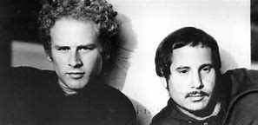
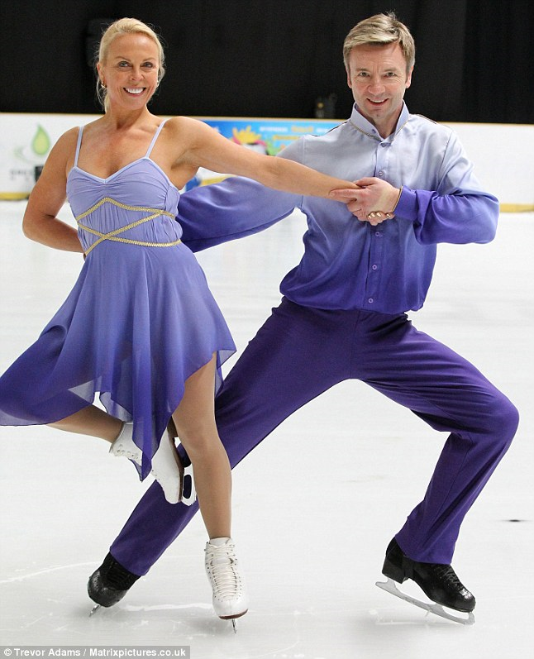
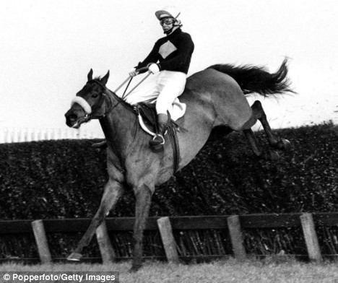
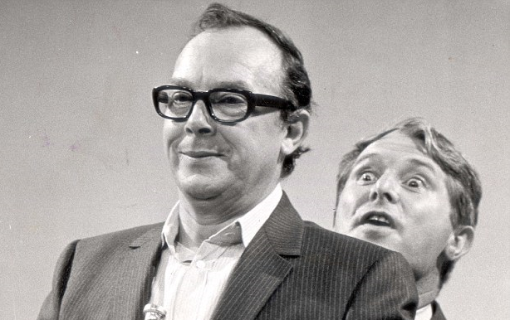
…setting the scene….
Notes:
I want to spend time this morning setting the scene so that by the end of our discussions, there is an understanding that monitoring and evaluation go hand in hand , whether it is the school’s ongoing, systematic approach to monitoring and evaluating the impact of:
The school’s development plan
The curriculum
Quality of teaching
Safeguarding
Leadership and management etc
…or whether it is monitoring and evaluating the impact of actions on a RAP. This afternoon’s session will be covering the 6 steps to successful school improvement planning and will include monitoring and evaluating as part of the discussions.
So, like:
Brian Fletcher and Red Rum
Fred Astaire and Ginger Rogers
Torvill and Dean
Simon and Garfunkel
…monitoring and evaluating are ‘joined at the hip!’

Slide 29


Monitoring is the collection of information about the school’s performance.
Evaluation relates to the judgements made about the information collected, in simple terms, what is working and what should be improved. Both are critical components of successful school development.

Slide 30

Six Honest Men
I keep six honest serving men, who taught me all I know.
Their names are what and why and when and how and where and who. Rudyard Kipling, 1856-1936-from ‘The Elephant’s Child’, in the Just So Series.
Notes:
As Margaret has already alluded to in the performance management event, Rudyard Kipling’s ‘six honest serving men’, is an ideal framework for the questions that we want to answer throughout each event. We will aim to be consistent again today, and cover all six questions.

Slide 31

…what?
Notes:
Group to have time here to talk briefly about what they are.

Slide 32


Examples include:
Planning scrutiny
Lesson Visits
Work scrutiny
Discussions with teachers, pupils and other leaders
Analysis of achievement including results
Checking documents, plans, records etc
(Also see ‘How’ later…)

Slide 33

Evidence used to evaluate the impact of leaders’ work includes:
Meetings with leaders to discuss how well they know the school and the quality of education that it provides for pupils
Documentary evidence provided by the school that demonstrates the effectiveness of the school’s provision
Ofsted Section 5 Handbook para 275

Slide 34
Sources of Evidence Specific to Curriculum Intent
‘If leaders have an accurate evaluative understanding of current curriculum practice in their school and have identified appropriate next steps to improve curriculum quality and develop curriculum expertise across the school, inspectors will evaluate intent favourably…’
Ofsted Section 5 Handbook para 180

Slide 35

…why?
Notes:
In summary, let’s remind ourselves of the reasoning behind monitoring and evaluation.

Slide 36
They check that all pupils’ needs are being met and that the school is achieving its aims in relation to:
The quality of education
The behaviour and attitudes of pupils
The personal development of pupils
Leadership and management
Safeguarding

Slide 37

…for ‘testing the temperature’, and checking impact of planned actions
…. so you know what to do next

Slide 38
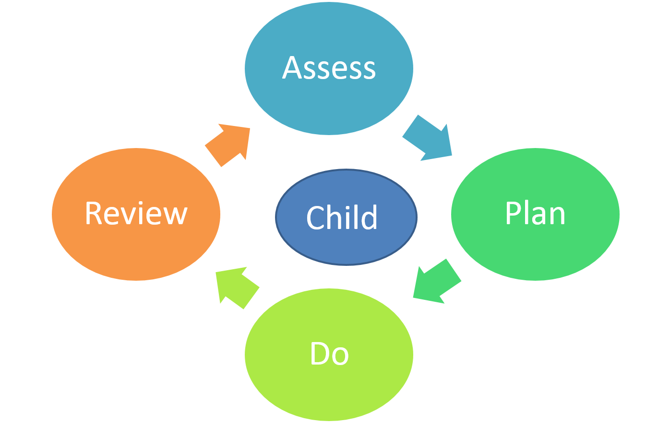
Notes:
Remember it is a continuous cycle.

Slide 39
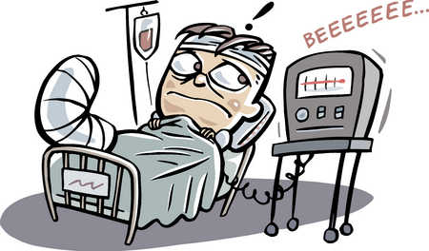
Without a systematic approach to monitoring and evaluating there could be a declining picture emerging over time
Notes:
What might those symptoms be?

Slide 40
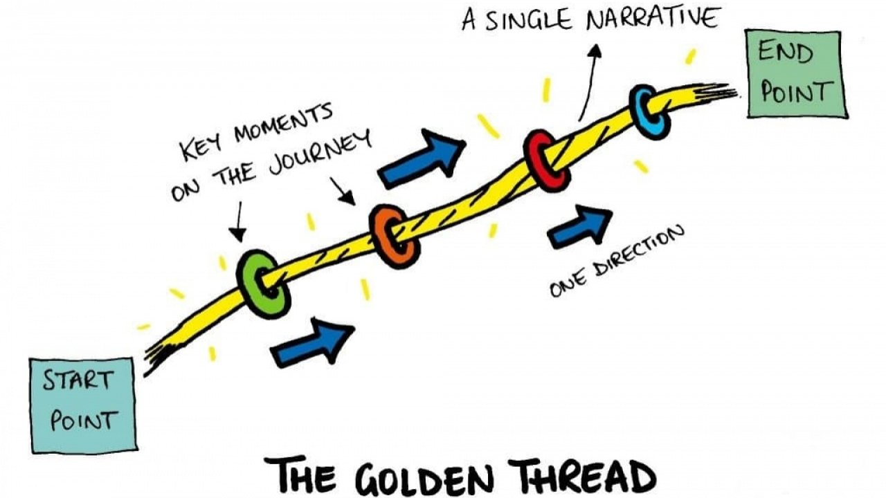
Notes:
It is the golden thread throughout the school improvement journey and beyond.
Time for lunch!
This afternoon you will be working through the six steps to successful steps to improvement planning.

Slide 41
…when?
Notes:
A school’s ongoing monitoring and evaluation system will be framed around the academic year and timetabled by the leadership team to be an effective school improvement tool.
Her are some examples. They are in your packs also.
The first one is
Wholes school
Governor – 2 examples
Subject leader
Pupil survey
Staff survey

Slide 42
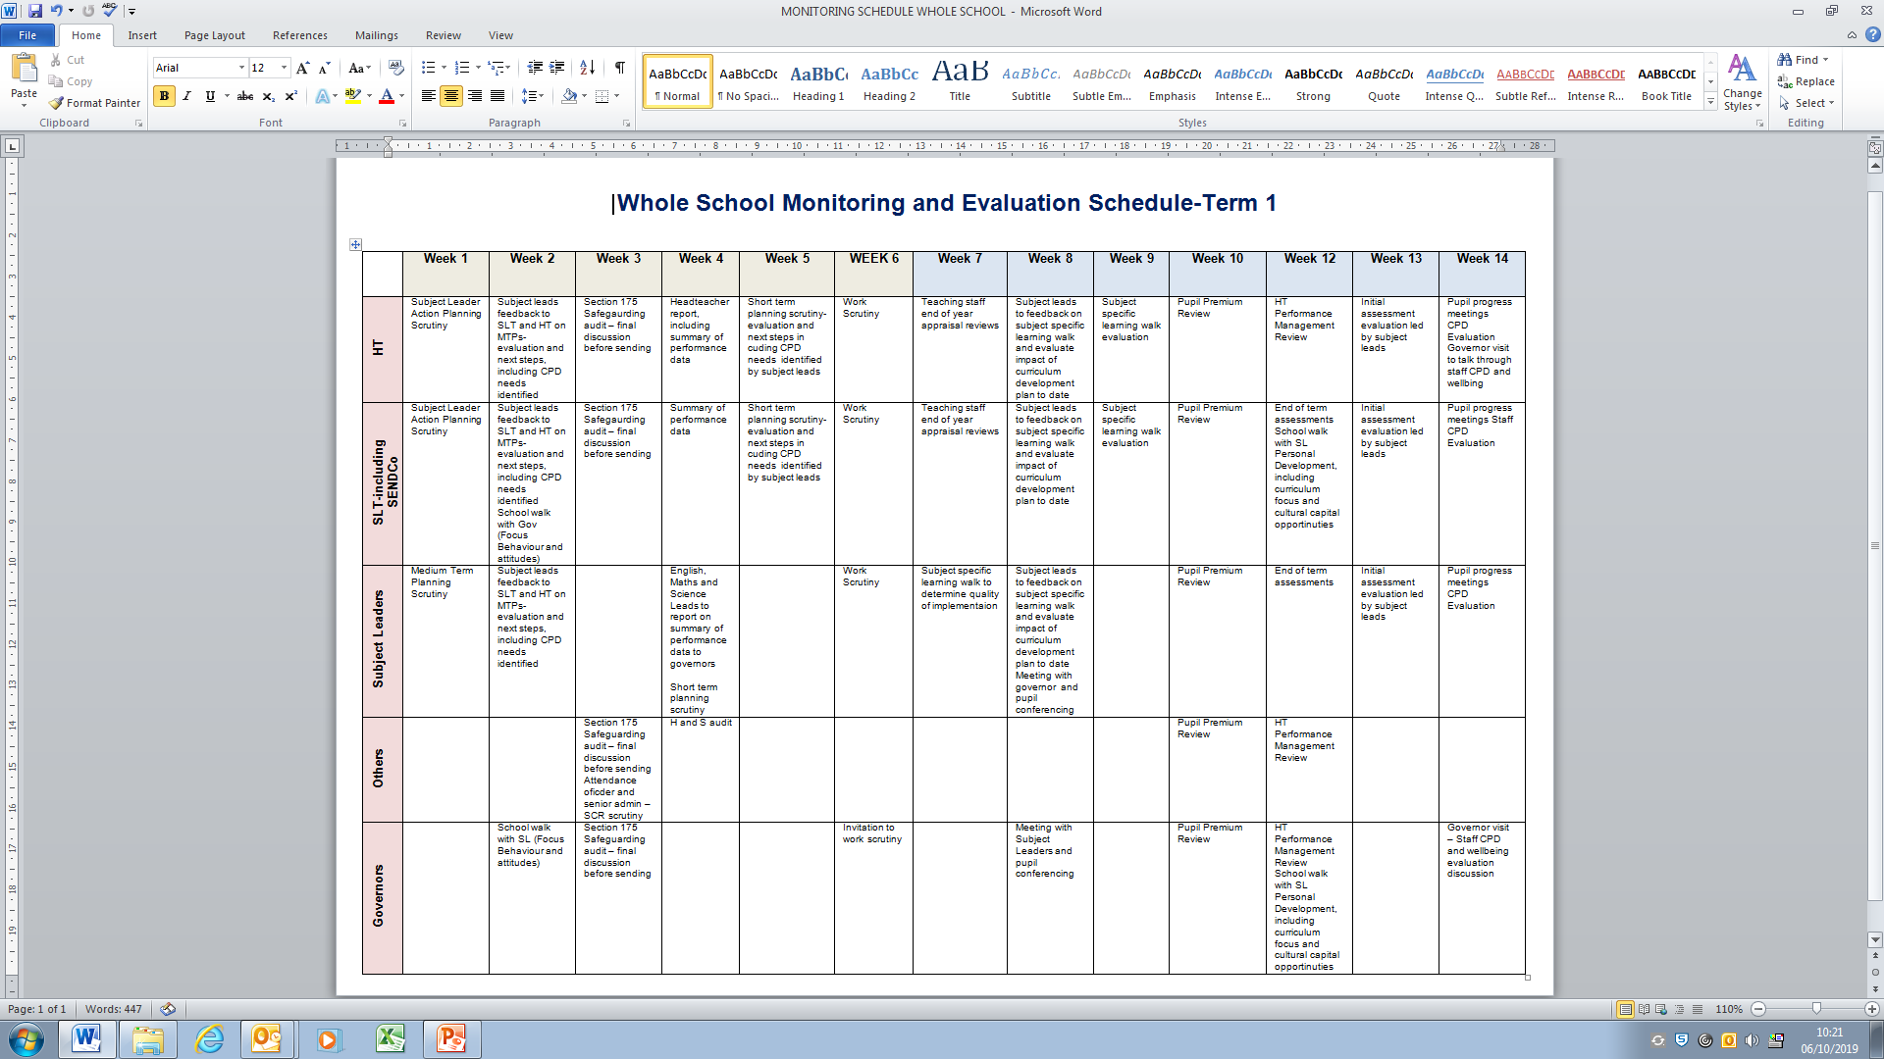
Notes:
HANDOUT 1 This is an example of how a school has set up a timetable for ongoing monitoring and evaluation through a term. You have a copy with the example activities and also

Slide 43
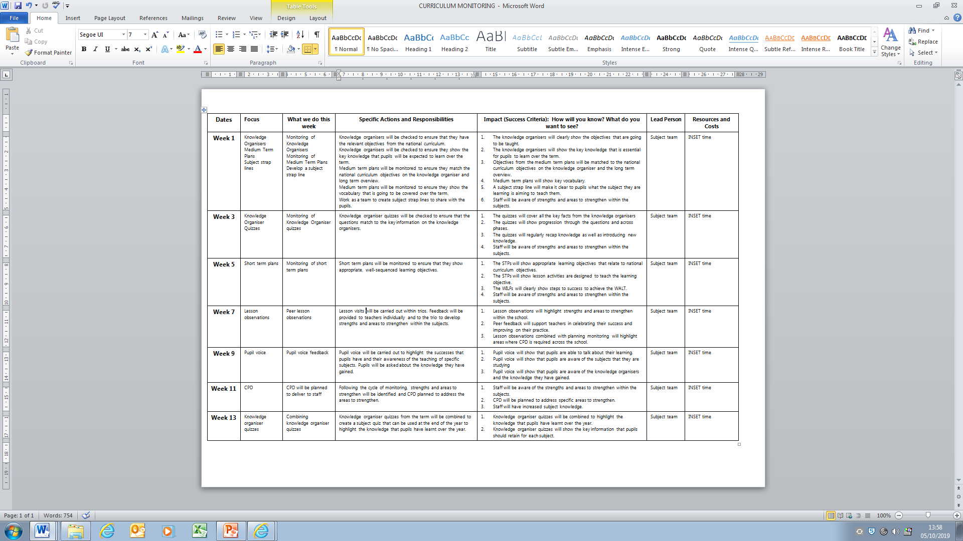
Notes:
HAND OUT 2 This is another example with very explicit impact statements. It is a monitoring and evaluation timetable specifically for a subject lead.

Slide 44
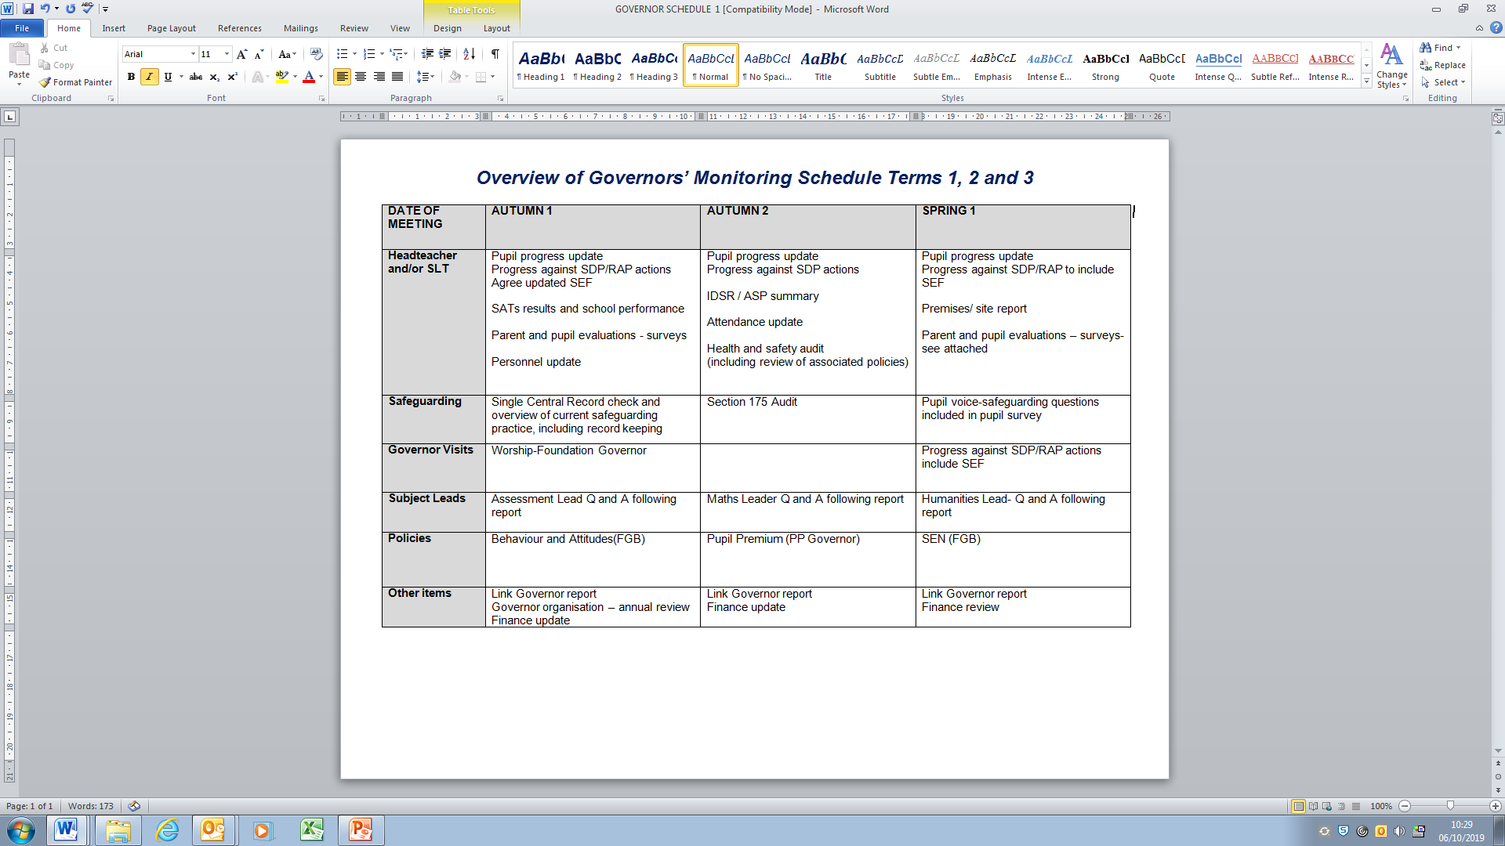
Notes:
HANDOUT 3 And finally, this next example is specific to governors.

Slide 45


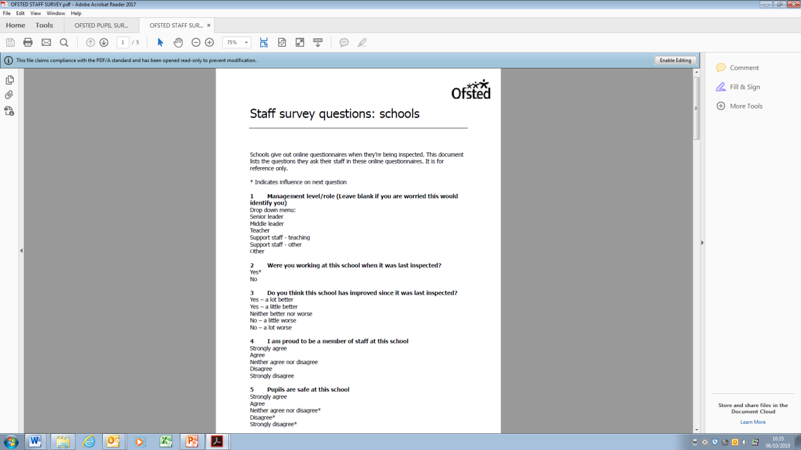
Notes:
HANDOUT 4/5/6 Here are examples of monitoring that are completed by Ofsted, as part of their inspection. The pupil and staff survey were published in January 2018. The guidance explains that the pupil survey can be completed up to 11.00am on the first day and up to 11.00am on the second day for staff. The parent view questions were updated to reflect the 2019 framework but there is no indication that the staff and pupil ones have been.
These are all useful tools for schools to help craft their own surveys.

Slide 46

Notes:
Once you have a CYCLE, you create rhythm, momentum and consistency.

Slide 47

…How?
Notes:
A school’s ongoing monitoring and evaluation system will be framed around the academic year and timetabled by the leadership team to be an effective school improvement tool.
Her are some examples. They are in your packs also.
The first one is
Wholes school
Governor – 2 examples
Subject leader
Pupil survey
Staff survey

Slide 48

Monitoring Quality of Education
Use guidance in Ofsted handbook (see some draft format examples)
Think about where specific monitoring of teaching fits in to monitoring quality of education
Try to echo ‘deep dive’ methodology…

Slide 49
Monitoring Intent
Check thoroughness of intent and planning for progression; if this isn’t the best it can be, everything else follows it

Slide 50
Monitoring Intent
Do staff deeply understand ARE in each subject and key intent that leads to being a historian, a musician etc.
Check each cohort’s curriculum journey to this point and plan for their experiences going forward.
Consider quality CPD for subject leaders and signpost to professional bodies (e.g. the Historical Association) to draw on research and subject expertise
Work with other schools to check and share ideas
Ensure links to school’s overall curriculum intent, the context of the school and pupils’ needs locally e.g. S and L

Slide 51
Monitoring Intent
Check medium term/topic plans for curriculum content and coverage over time
Check compliance with the school’s intent and progression models
Check for appropriate cross-curricular links

Slide 52
Monitoring Implementation
Is the teaching bringing the curriculum plans to life?
How well is the curriculum taught and assessed? (see para 183)
Draw on, and connect together, findings from:
Content of the curriculum plans
Lesson visits (see paras 98-101)
Work scrutiny (see paras 102-104)
Talking to teachers - to understand how they have planned for progression and to help pupils remember their learning
Talking to pupils - with their books - to establish how well they have learnt the curriculum

Slide 53
Monitoring impact
Using all of your evidence from lesson visits, work scrutiny, discussions with pupils, teachers, etc:
How well is the curriculum intent being met for pupils, including SEND and other groups?
Are pupils learning more, remembering more, doing more and meeting age related expectations in their subject?
Do statutory results reflect that?
How well prepared are pupils for their next stage i.e. in their knowledge and skills?

Slide 54
Monitoring impact
What is your school’s approach to assessing pupil outcomes in all subjects across the curriculum?
How do you use this assessment information
Is this shared with governors?
What is it telling you about how well pupils are learning different subjects of the curriculum and how ready they are for the next stage of their education?

Slide 55
…who?
Notes:
Group to have time here to talk briefly about what they are.
In relation to different aspects of the quality of education monitoring that we have just discussed – who in your school might undertake the different aspects?

Slide 56

Headteacher
Governors
Teachers
Parents
Pupils
MDSAs
Other Support Staff
Local Authority
Teaching Assistants
Senior Leaders
Curriculum Leaders
Ofsted
Other external bodies
Notes:
13 …are there more?

Slide 57
…where?
Notes:
Group to have time here to talk briefly about what they are.
In relation to different aspects of the quality of education monitoring that we have just discussed – who in your school might undertake the different aspects?

Slide 58
In the…
classroom books
playground
corridors
lunch hall
intervention room
documentation
website

Slide 59

Up and coming events…

Slide 60

Closing the Gap Conference
on
21st November 2019
at
Cheltenham Chase Hotel
For
Headteachers, Governors and/or Senior Leaders
Notes:
It is the golden thread throughout the school improvement journey and beyond.
Time for lunch!
This afternoon you will be working through the six steps to successful steps to improvement planning.

Slide 61

RAP Writing Master Class
on
Thursday 5th December 2019
at
Jurys Inn Cheltenham
For
Headteachers, Governors and/or Senior Leaders
Notes:
It is the golden thread throughout the school improvement journey and beyond.
Time for lunch!
This afternoon you will be working through the six steps to successful steps to improvement planning.

Slide 62
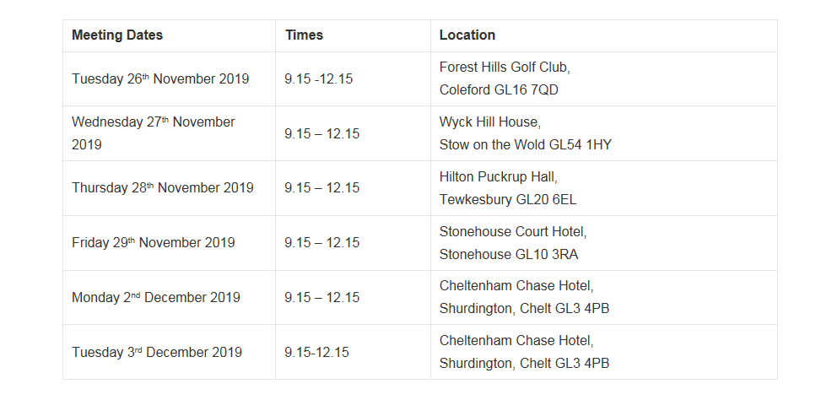
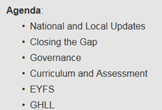
Primary Headteacher and Chair of Governors Briefings
Notes:
It is the golden thread throughout the school improvement journey and beyond.
Time for lunch!
This afternoon you will be working through the six steps to successful steps to improvement planning.

Slide 63
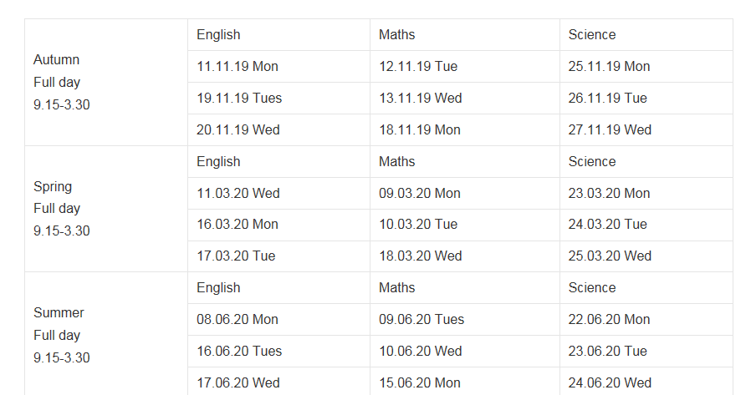

Primary Subject Leader Network Meetings
The Pavilion, Cheltenham
Notes:
It is the golden thread throughout the school improvement journey and beyond.
Time for lunch!
This afternoon you will be working through the six steps to successful steps to improvement planning.

